Slide 1

AI DRIVEN COGINIVITE HEALTH MONITIRING SYSTEM
JERUSALEM COLLEGE OF ENGINEERING, CHENNAI-100
DEPARTMENT OF INFORMATION TECHNOLOGY
SUPERVISED BY
JERINA BEGUM S
ASST. PROFESSOR
DEPARTMENT OF IT
PRESENTED BY
THYAGARAAJ D.S (130721205051)
BHARATHIKANNAN (130721205007)

Slide 2
ABSTRACT
Neurodegenerative conditions such as Alzheimer's and Parkinson's are highly diagnostic, especially during their initial phases.
This work suggests a hybrid deep learning architecture combining Gray-Level Co-Occurrence Matrix (GLCM)-based texture analysis with a deep learning model, e.g., LSTM or CNN-LSTM, to improve disease prediction from brain MRI scans.
The GLCM technique derives essential texture features, retaining structural aberrations, and the LSTM learns temporal patterns of disease progression. The system, by integrating these methods
The advantages of the model are heightened sensitivity to structural aberrations, enhanced classification accuracy, and a scalable solution for clinical use in neurodegenerative disease detection.

Slide 3
OBJECTIVE
To extract and analyze texture features from MRI images using GLCM, which capture fine-grained structural changes often missed by traditional methods.
To implement an automated, non-invasive diagnostic pipeline that minimizes reliance on subjective clinical assessments and traditional neuroimaging limitations.
To enhance the accuracy of early-stage diagnosis of neurodegenerative diseases like Alzheimer’s and Parkinson’s by identifying subtle structural abnormalities in brain MRI scans.

Slide 4
.
EXISTING SYSTEM
Traditional diagnosis based on clinical symptoms and neuroimaging Manual
AI models mostly use CNNs on MRI images.
GLCM used in other medical imaging areas, not widely in neurodegeneration.
LSTM/CNN-LSTM used mostly in time-series medical data, not combined with GLCM.

Slide 5
.
PROPOSED SYSTEM
Step 1: Preprocess brain MRI images.
Step 2: Extract texture features using GLCM.
Step 3: Feed features into LSTM/CNN-LSTM to learn spatial/temporal patterns.
Step 4: Classify disease stage.
Provide results with high sensitivity and low false positivesMulti-Mode

Slide 6
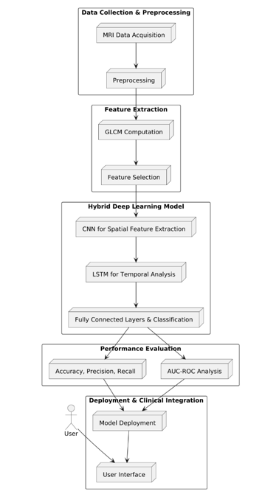
BLOCK DIAGRAM OF PROPOSED SYSTEM

Slide 7
MODULE 1
Data Acquisition Module
Collects brain MRI datasets (e.g., Alzheimer’s, Parkinson’s)
Supports various image formats like DICOM, NIfTI, JPEG.Ensures balanced dataset across disease stages.
Input: Raw MRI Scans

Slide 8
MODULE 2
Preprocessing Module
Normalizes MRI images (resizing, noise removal, contrast enhancement).
Converts to grayscale (for GLCM processing).
Applies skull-stripping or region-of-interest isolation (optional).
Purpose: Clean, consistent images ready for analysis.

Slide 9
MODULE 3
Feature Extraction Module (GLCM-Based)
Uses Gray-Level Co-Occurrence Matrix (GLCM) to extract texture features:
Contrast
Correlation
Homogeneity
These features reveal fine structural patterns in the brain.
Output: Feature vector representing MRI texture.

Slide 10
MODULE 4
4. Deep Learning Module (LSTM or CNN-LSTM)
Inputs: GLCM feature vectors or spatial data.
LSTM used for modeling progression (temporal patterns).
CNN-LSTM optionally used to extract spatial features before sequence modeling.
Learns patterns associated with disease stages.

Slide 11
MODULE 5
5. Classification Module
Final layer predicts the disease stage or condition.
Outputs probability/confidence score.
Uses softmax or sigmoid depending on binary/multi-class problem.

Slide 12
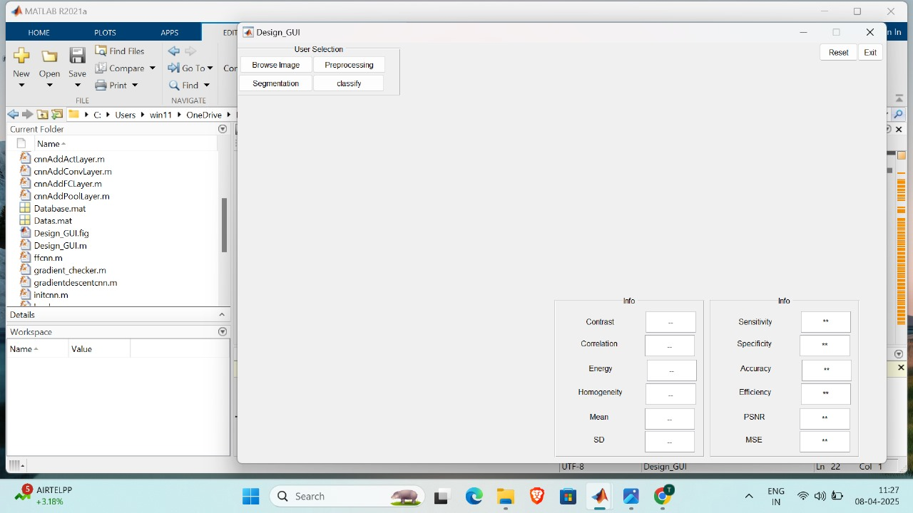
HOMEPAGE

Slide 13
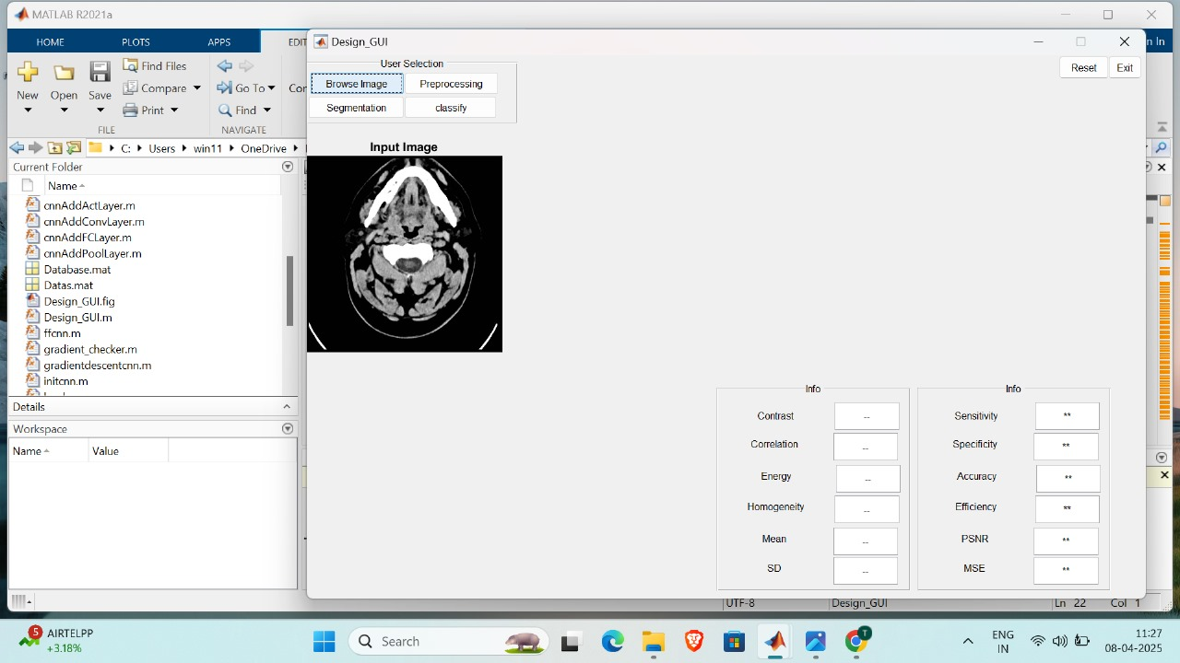
CHECK IN MODULE

Slide 14
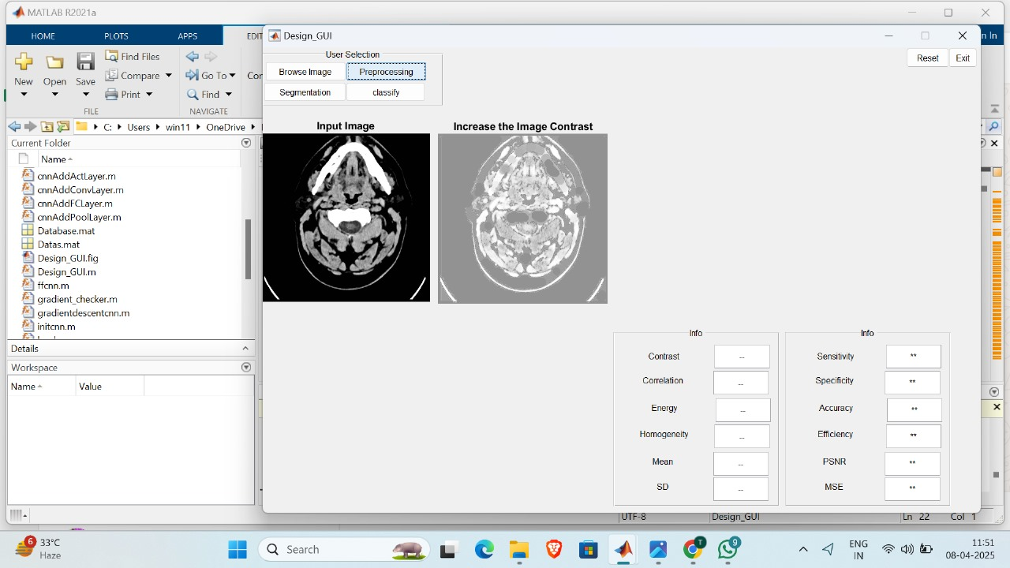
SOFTCOPY MODULE

Slide 15
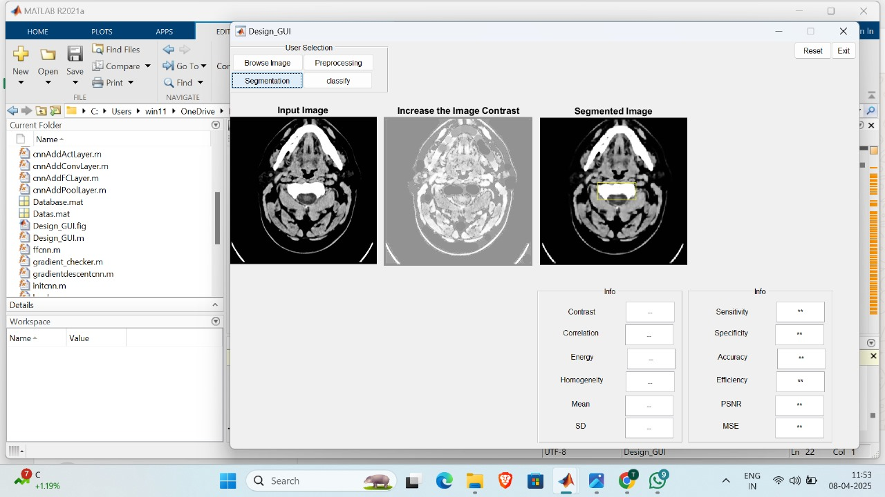
HARDCOPY MODULE

Slide 16
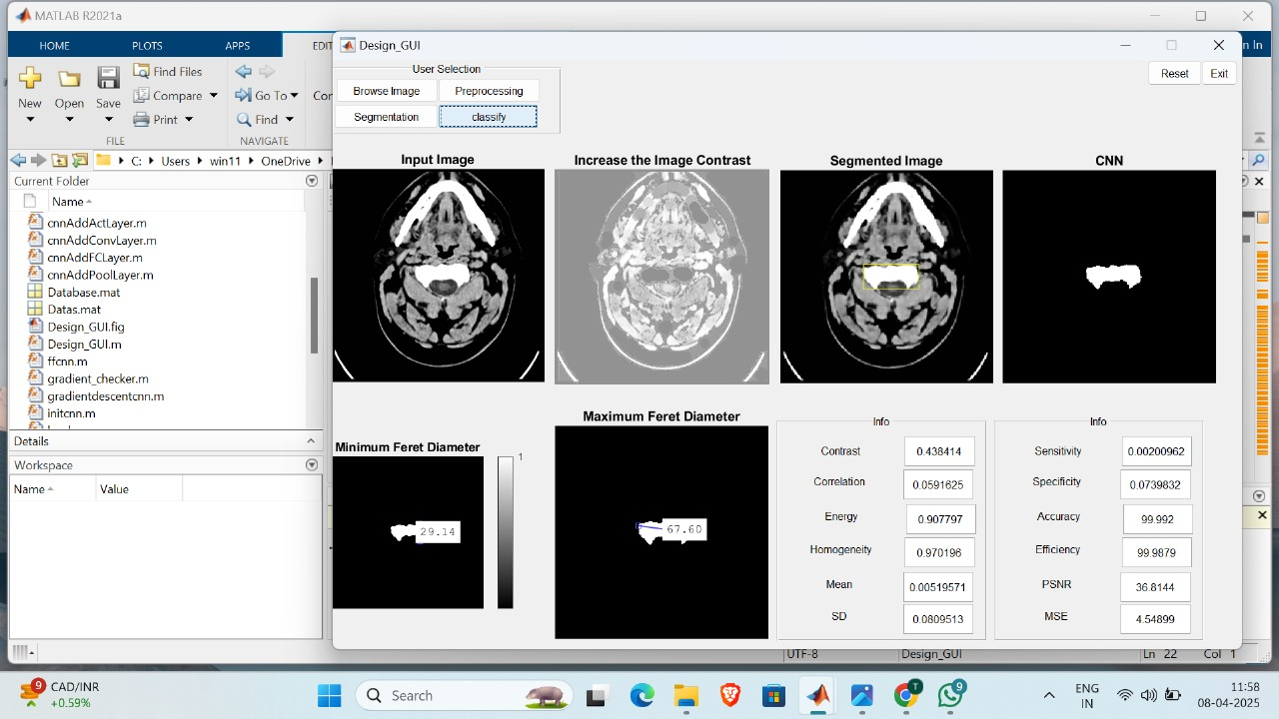
MANUAL REGISTRATION MODULE

Slide 17
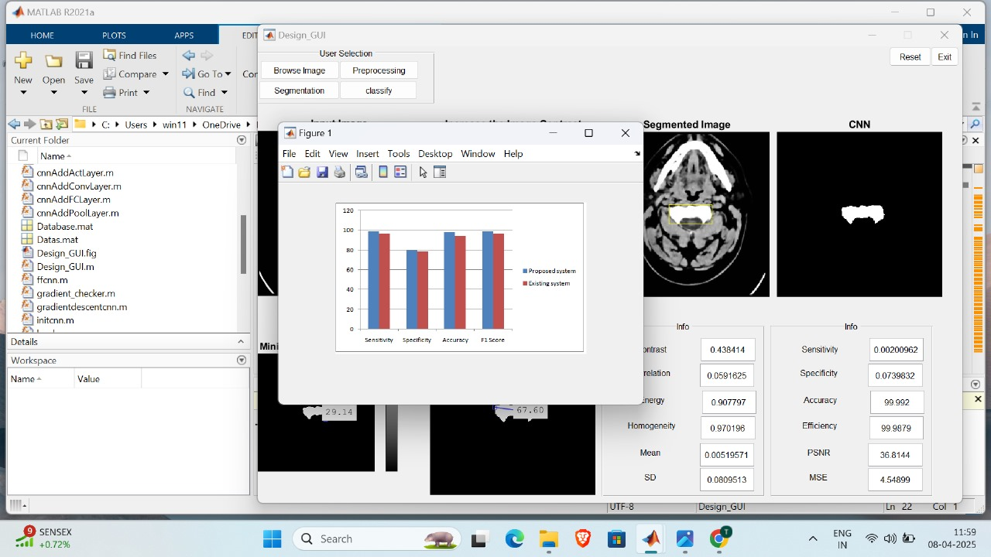
ADMIN ACCESS CONTROL

Slide 18
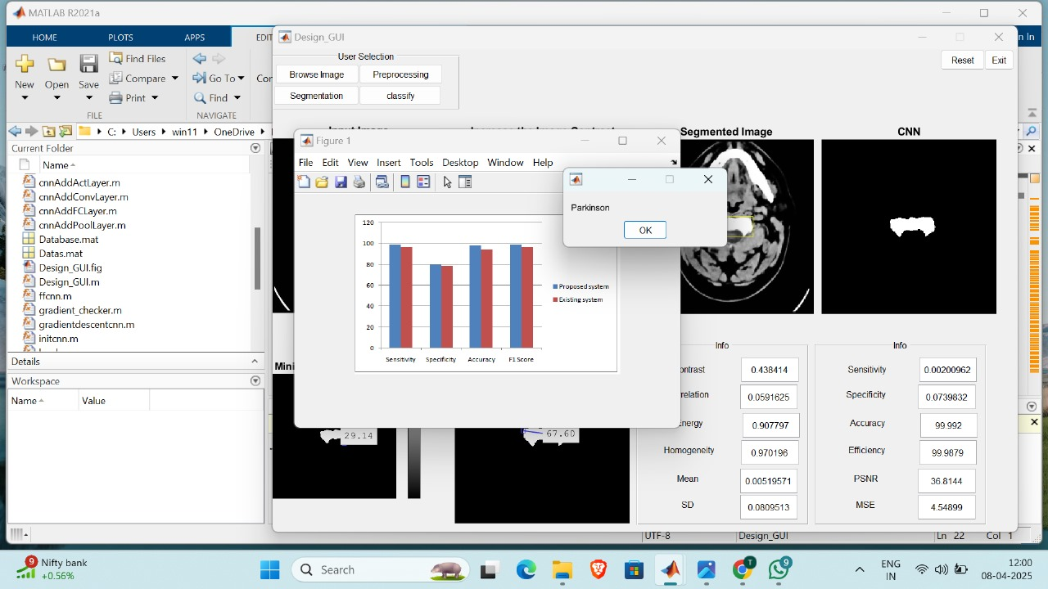
REGISTRATION RECORDS

Slide 19
CONCLUSION
The proposed hybrid system effectively combines GLCM-based texture analysis with deep learning (LSTM / CNN-LSTM) for accurate early detection of neurodegenerative diseases.
The integration of traditional image processing with AI models enhances diagnostic sensitivity and classification accuracy.
The model enables an automated, non-invasive, and scalable solution, suitable for clinical use.
This approach supports early-stage diagnosis, which is crucial for effective treatment and improved patient outcomes.

Slide 20
THANK YOU

